Slide 1
Microprocessors and Assembly Language Lecture 6 Hamed Farbeh farbeh@aut.ac.ir Spring 2023
Notes:
مباحث اسمبلی در این لکچر برای آشنایی بیشتر است و در امتحان نخواهد بود.

Slide 2
Copyright Notice
Parts (text & figures) of this lecture are adopted from:
Arm Assembly Language Programming and Architecture, Volume 1, 1st edition, Muhammad Ali Mazidi, Sarmad Naimi, and Sepehr Naimi, MicroDigitalEd, 2013
Design of Microprocessor-Based Systems (AKA Embeded Systems Design and Implementation), Prabal Dutta, University of Michigan
Cortex™-M3 Revision r2p1 Technical Reference Manual
ARMv7-M Architecture Reference Manual

Slide 3
Parallel Input/Output Controller (PIO)

Slide 4

PIO Description
Parallel Input/Output Controller (PIO)
The microprocessor of our course has 144 lines
manages up to 32 bit fully programmable input/output lines
As you may recall, a microcontroller is a processor with a set of peripherals
Each I/O line may be dedicated as a general-purpose I/O or be assigned to a function of an embedded peripheral
Chapter 31: Atmel | SMART ARM-based MCU DATASHEET, SAM3X / SAM3A Series, Atmel-11057C-ATARM-SAM3X-SAM3A-Datasheet_23-Mar-15

Slide 5
PIO Description
Each I/O line of the PIO Controller features:
An input change interrupt enabling level change detection on any I/O line.
Additional Interrupt modes enabling rising edge, falling edge, low level or high level detection on any I/O line.
A glitch filter providing rejection of glitches lower than one-half of system clock cycle
A debouncing filter providing rejection of unwanted pulses from key or push button operations
Chapter 31: Atmel | SMART ARM-based MCU DATASHEET, SAM3X / SAM3A Series, Atmel-11057C-ATARM-SAM3X-SAM3A-Datasheet_23-Mar-15

Slide 6
PIO Description
Each I/O line of the PIO Controller features:
Multi-drive capability similar to an open drain I/O line (At any moment of time, it can only take value from one line and the rest must be in high impedance state)
Control of the pull-up of the I/O line
Input visibility and output control
A synchronous output providing up to 32 bits of data output in a single write operation
Chapter 31: Atmel | SMART ARM-based MCU DATASHEET, SAM3X / SAM3A Series, Atmel-11057C-ATARM-SAM3X-SAM3A-Datasheet_23-Mar-15

Slide 7
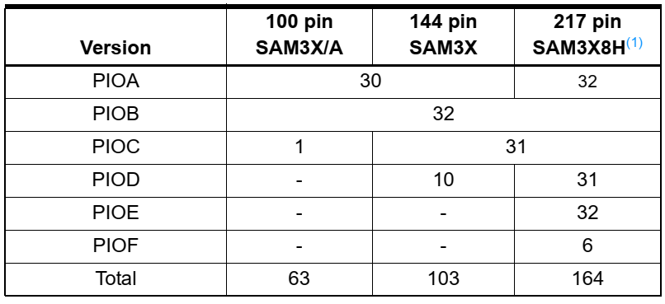
PIO Description (Datasheet)
Parallel Input/Output Controller (PIO)
Each PIO Controller controls up to 32 programmable I/O Lines
The microcontroller discussed, is 144pin SAM3X
Chapter 31: Atmel | SMART ARM-based MCU DATASHEET, SAM3X / SAM3A Series, Atmel-11057C-ATARM-SAM3X-SAM3A-Datasheet_23-Mar-15

Slide 8
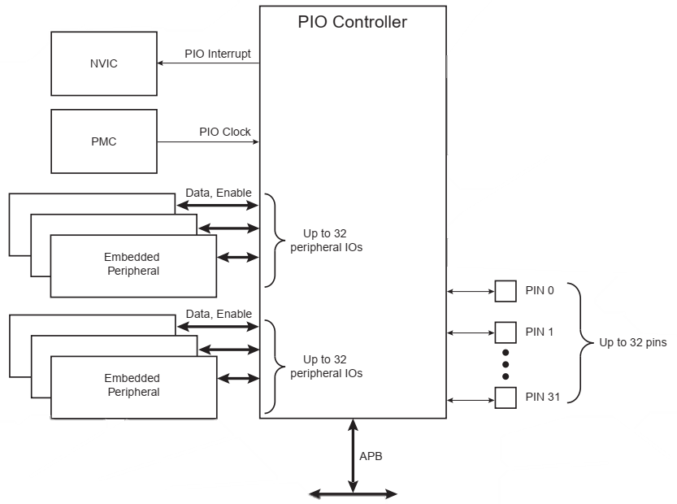
PIO Block Diagram
Chapter 31: Atmel | SMART ARM-based MCU DATASHEET, SAM3X / SAM3A Series, Atmel-11057C-ATARM-SAM3X-SAM3A-Datasheet_23-Mar-15

Slide 9
Product Dependencies
Pin Multiplexing
Each pin is configurable, according to product definition
A general-purpose I/O line only
An I/O line multiplexed with one or two peripheral I/Os
Power Management (PMC; Power Management Controller)
Controls the PIO Controller clock in order to save power (It is even possible to stop the PIO Controller’s clock)
Writing any of the registers of the user interface does not require the PIO Controller clock to be enabled
Chapter 31: Atmel | SMART ARM-based MCU DATASHEET, SAM3X / SAM3A Series, Atmel-11057C-ATARM-SAM3X-SAM3A-Datasheet_23-Mar-15

Slide 10
Product Dependencies
Power Management (Cont’d)
Not all of the features of the PIO Controller are available when the clock is disabled
Input Change Interrupt, Interrupt Modes on a programmable event and the read of the pin level require the clock to be validated
After a hardware reset, the PIO clock is disabled by default (So the clock must be enabled manually)
The user must configure the Power Management Controller before any access to the input line information
Chapter 31: Atmel | SMART ARM-based MCU DATASHEET, SAM3X / SAM3A Series, Atmel-11057C-ATARM-SAM3X-SAM3A-Datasheet_23-Mar-15

Slide 11
Product Dependencies
Interrupt Generation
The PIO Controller is connected on one of the sources of the NVIC
Using the PIO Controller requires the NVIC to be programmed first
The PIO Controller interrupt can be generated only if the PIO Controller clock is enabled
Chapter 31: Atmel | SMART ARM-based MCU DATASHEET, SAM3X / SAM3A Series, Atmel-11057C-ATARM-SAM3X-SAM3A-Datasheet_23-Mar-15

Slide 12
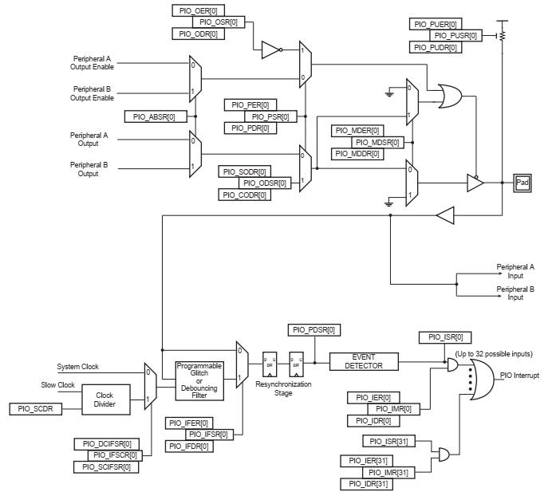
The internal circuit of a pin

Slide 13

Functional Description
Pull-up Resistor Control
PIO_PUER: Pull-up Resistor Control
PIO_PUSR: Pull-up Status Register
After reset, all of the pull-ups are enabled, i.e. PIO_PUSR resets at the value 0x0
Chapter 31: Atmel | SMART ARM-based MCU DATASHEET, SAM3X / SAM3A Series, Atmel-11057C-ATARM-SAM3X-SAM3A-Datasheet_23-Mar-15

Slide 14
Functional Description
I/O Line or Peripheral Function Selection
PIO_PER: PIO Enable Register
PIO_PDR: PIO Disable Register
PIO_PSR: PIO Status Register
indicates whether the pin is controlled by the corresponding peripheral or by the PIO Controller, if 0:
pin is controlled by the corresponding on-chip peripheral selected in the PIO_ABSR (AB Select Register)
Chapter 31: Atmel | SMART ARM-based MCU DATASHEET, SAM3X / SAM3A Series, Atmel-11057C-ATARM-SAM3X-SAM3A-Datasheet_23-Mar-15

Slide 15
Functional Description
Output Control
PIO_OER: Output Enable Register
PIO_ODR: Output Disable Register
PIO_OSR: Output Status Register
When a bit in this register is at 0, the corresponding I/O line is used as an input only
When the bit is at 1, the corresponding I/O line is driven by the PIO controller
Chapter 31: Atmel | SMART ARM-based MCU DATASHEET, SAM3X / SAM3A Series, Atmel-11057C-ATARM-SAM3X-SAM3A-Datasheet_23-Mar-15

Slide 16
Functional Description
Output Control (Cont’d)
PIO_SODR: Set Output Data Register
PIO_CODR: Clear Output Data Register
PIO_ODSR: Output Data Status Register
To send each bit of parallel data to the output, PIO_SODR and PIO_CODR must be set to generate Output Data Status
Chapter 31: Atmel | SMART ARM-based MCU DATASHEET, SAM3X / SAM3A Series, Atmel-11057C-ATARM-SAM3X-SAM3A-Datasheet_23-Mar-15

Slide 17
Functional Description
Output Control (Cont’d)
PIO_OWSR: Output Write Status Register
PIO_OWER: Output Write Enable Register
PIO_OWDR: Output Write Disable Register
Chapter 31: Atmel | SMART ARM-based MCU DATASHEET, SAM3X / SAM3A Series, Atmel-11057C-ATARM-SAM3X-SAM3A-Datasheet_23-Mar-15

Slide 18
Functional Description
Synchronous Data Output (It must be sent synchronously)
Simultaneous write into PIO_SODR and PIO_CODR is not possible
PIO Controller offers a direct control of PIO outputs by single write access to PIO_ODSR
Only bits unmasked by PIO_OWSR are written. The mask bits in PIO_OWSR are set by writing to PIO_OWER and cleared by writing to PIO_OWDR.
After reset, the synchronous data output is disabled on all the I/O lines as PIO_OWSR resets at 0x0
Chapter 31: Atmel | SMART ARM-based MCU DATASHEET, SAM3X / SAM3A Series, Atmel-11057C-ATARM-SAM3X-SAM3A-Datasheet_23-Mar-15

Slide 19

Functional Description
Multi Drive Control (Open Drain)
Permits several drivers to be connected on the I/O line which is driven low only by each device
PIO_MDER: Multi-driver Enable Register
PIO_MDSR: indicates the pins that are configured to support external drivers
After reset, the Multi Drive feature is disabled on all pins (PIO_MDSR = 0)

Slide 20
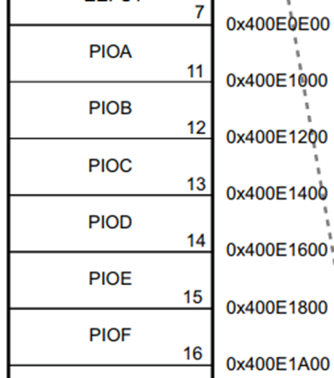
How to Use Datasheet for GPIO Operations
Atmel | SMART ARM-based MCU DATASHEET, SAM3X / SAM3A Series, Atmel-11057C-ATARM-SAM3X-SAM3A-Datasheet_23-Mar-15
http://ww1.microchip.com/downloads/en/DeviceDoc/Atmel-11057-32-bit-Cortex-M3-Microcontroller-SAM3X-SAM3A_Datasheet.pdf
Step 1: from the "functional description“ section, determine registers you want to change for reading or writing operation (page 621)
Step 2: from the “product mapping” section, determine starting address of the PIO Controller you want to work with (page 31)

Slide 21
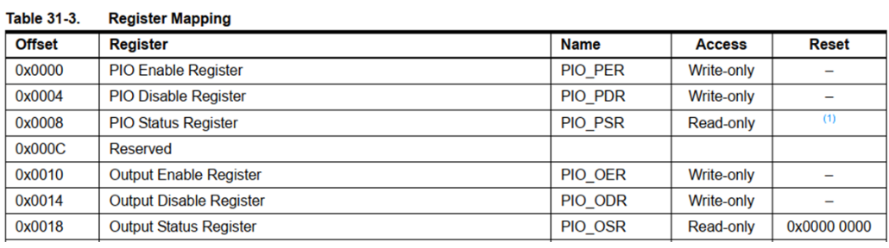
How to Use Datasheet for GPIO Operations
Step 3: from the “Parallel Input/Output Controller (PIO) User Interface” section, determine the offset of each register in the corresponding PIO Controller (pages 631-632)
_ Address of register in memory = Start Address of PIO Controller + Offset of register

Slide 22
How to Use Datasheet for GPIO Operations
Each I/O line controlled by the PIO Controller is associated with a bit in each of the PIO Controller User Interface registers. Each register is 32 bits wide. If a parallel I/O line is not defined, writing to the corresponding bits has no effect. Undefined bits read zero. If the I/O line is not multiplexed with any peripheral, the I/O line is controlled by the PIO Controller and PIO_PSR returns 1 systematically.
Step 4: check PIO Write Protect Mode Register(PIO_WPMR) (Page 674)

Slide 23
Write Protect Registers
To prevent any single software error that may corrupt PIO behavior, certain address spaces can be write-protected by setting the WPEN bit in the “PIO Write Protect Mode Register” (PIO_WPMR)
PIO registers can only be written if the WPEN bit is cleared in PIO_WPMR
WPEN: Write Protect Enable
0: Disables the Write Protect if WPKEY corresponds to 0x50494F (“PIO” in ASCII)
1: Enables the Write Protect if WPKEY corresponds to 0x50494F (“PIO” in ASCII)

Slide 24
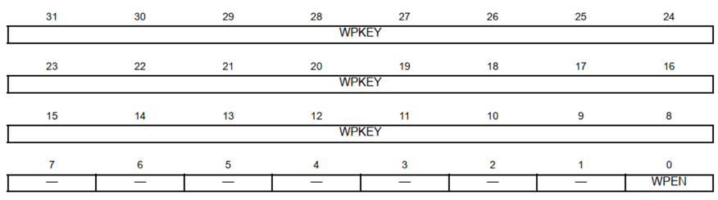
Write Protect Registers
WPKEY: Write Protect KEY
Should be written at value 0x50494F (“PIO” in ASCII). Writing any other value in this field aborts the write operation of the WPEN bit. Always reads as 0

Slide 25
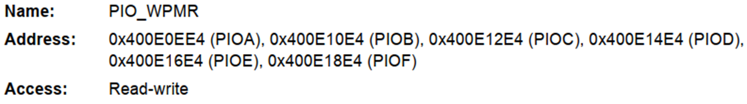
PIO Write Protect Mode Register (PIO_WPMR)
Each PIO Controller has its own PIO_WPMR
“PIO_WPMR protects the following registers:
“PIO Controller PIO Enable Register”
“PIO Controller PIO Disable Register”

Slide 26
PIO Write Protect Mode Register (PIO_WPMR)
“PIO Controller Output Enable Register”
“PIO Controller Output Disable Register”
“PIO Controller Input Filter Enable Register”
“PIO Controller Input Filter Disable Register”
“PIO Multi-driver Enable Register”
“PIO Multi-driver Disable Register”
“PIO Pull Up Disable Register”
“PIO Pull Up Enable Register”
“PIO Peripheral AB Select Register”
“PIO Output Write Enable Register”
“PIO Output Write Disable Register”

Slide 27
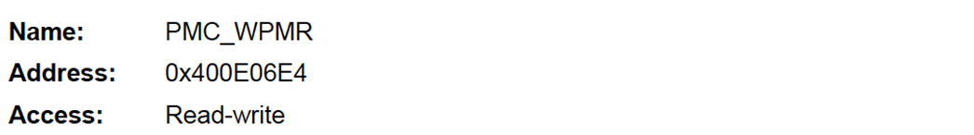
PIO Write Protect Mode Register (PIO_WPMR)
PMC System Clock Enable Register is write protected likewise the PIO registers
PMC_WPMR protects the following registers:
“PMC System Clock Enable Register”
“PMC System Clock Disable Register”
“PMC Peripheral Clock Enable Register 0”
“PMC Peripheral Clock Disable Register 0”

Slide 28
PMC Write Protect Mode Register(PMC_WPMR)
“PMC Clock Generator Main Oscillator Register”
“PMC Clock Generator PLLA Register”
“PMC Master Clock Register”
“PMC USB Clock Register”
“PMC Programmable Clock Register”
“PMC Fast Startup Mode Register”
“PMC Fast Startup Polarity Register”
“PMC Peripheral Clock Enable Register 1”
“PMC Peripheral Clock Disable Register 1”

Slide 29
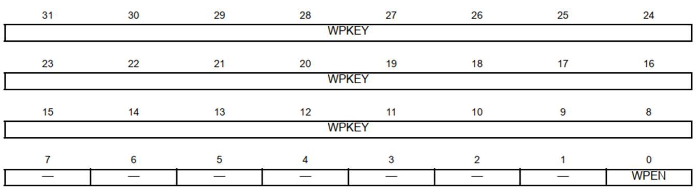
More on PMC Write Protect Mode Register
PMC registers can only be written if the WPEN bit is cleared in PMC_WPMR
WPEN: Write Protect Enable
0: Disables the Write Protect if WPKEY corresponds to 0x504D43 (“PMC” in ASCII)
1: Enables the Write Protect if WPKEY corresponds to 0x504D43 (“PMC” in ASCII)

Slide 30
More on PMC Write Protect Mode Register
WPKEY: Write Protect KEY
Should be written at value 0x504D43 (“PMC” in ASCII). Writing any other value in this field aborts the write operation of the WPEN bit. Always reads as 0

Slide 31
Change Value of Registers (Write)
Lets see how an led is turned on/off
For turning on/off an led we should write to certain registers
What should we do?
Enable PIO
Change the value of relevant register to turn on the led
Delay
Change the value of relevant register to turn off the led

Slide 32
Change Value of Registers (Write)
We should enable PIO at first :
PIO_PER = 1
PIO_OER = 1
Turn led on :
PIO_SODR = 1
Branch to delay part
Turn led off :
PIO_CODR = 1
Branch to delay part
Back to part 2

Slide 33
Change Value of Registers (Write) - Code
PIO_PER EQU 0x400E0E00 ; PIO Enable Register
PIO_OER EQU 0x400E0E10 ; Output Enable Register
PIO_SODR EQU 0x400E0E30 ; Set Output Data Register
PIO_CODR EQU 0x400E0E34 ; Clear Output Data Register
AREA MYCODE, CODE, READONLY
export __main
ENTRY
__main
BL enable_pio ; we should enable PIO at first
loop
BL led_on
BL delay
BL led_off
BL delay
B loop
enable_pio
MOV r4, #2_1
LDR r5, =PIO_PER ; r5 = address of PIO_PER register
STR r4, [r5] ; PIO_PER = 1
LDR r5, =PIO_OER ; r5 = address of PIO_OER register
STR r4, [r5] ; PIO_OER = 1
BX lr

Slide 34
Change Value of Registers (Write) - Code
led_on
MOV r4, #2_1
LDR r5, =PIO_SODR ; r5 = address of PIO_SODR register
STR r4, [r5] ; PIO_SODR = 1 ==> turn led on
BX lr
led_off
MOV r4, #2_1
LDR r5, =PIO_CODR ; r5 = address of PIO_CODR register
STR r4, [r5] ; PIO_CODR = 1 ==> turn led off
BX lr
delay
MOV r4, #0
LDR r5, =0x000A0000 ; delay time
delay_loop
ADD r4, r4, #1 ; r4 = r4 + 1
CMP r4, r5
BNE delay_loop
BX lr

Slide 35
Change Value of Registers (Read)
Here we want to read input from a GPIO pin, toggle it’s last bit (via XOR) and write the final value to the output register.
Steps for completing this task is as follows:
Clear IFSR by setting IFDR to 1 (to allow input read)
Read input from PDSR register
XOR input data with 1 to toggle it’s last bit to produce output
Write output data to ODSR register

Slide 36
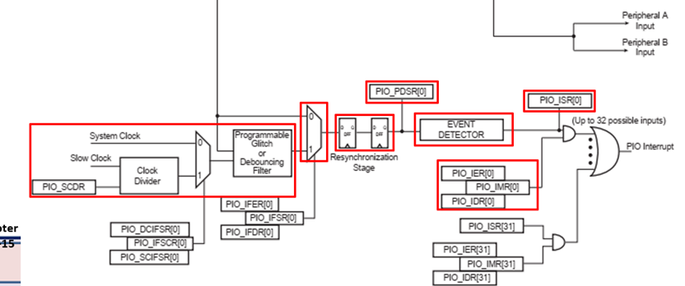
Change Value of Registers (Read)

Slide 37
Change Value of Registers (Write) - Code
PIOB EQU 0x400E1000
IFDR EQU 0x0024
PDSR EQU 0x003C
PIOA EQU z0x400E0E00
ODSR EQU 0x400E0E30
AREA MyCode, CODE, READONLY
export __main
ENTRY
__main
MOV R0, #1
LDR R1, =(PIOB + IFDR) ; load IFDR register address
STR R0, [R1] ; set IFDR register to 1, clearing IFSR register LDR R0, =(PIOB + PDSR) ; load input register address
LDR R1, =(PIOA + ODSR) ; load output register address
LOOP
B ReadIn
B WriteOut
B LOOP
ReadIn
LDR R2, [R0] ;read from input register
BX LR
WriteOut
MOV R3, #1
EOR R4, R3 ; toggle last bit
STR R3, [R1] ; write result to output register
BX LR

Slide 38
The End!

